Slide 1


Søren Wichmann
Leiden University Centre for Linguistics
Correlating languages and genes

Slide 2
3. Correlating languages and genes
A bit about genetics
Traditional approaches to the comparison of languages and genes using trees
A different approach using distances
Why correlation analyses are uninteresting
mtDNA, y chromosome, and linguistic distances: theoretically possible combinations and what they would suggest
mtDNA, y chromosome, and linguistic distances: attested combinations and what they suggest
Examples
Discussion and questions for future research

Slide 3
Caveats
Linguistic and genetic distances: assigning languages to genetic groups is error-prone since genetics reports rarely are clear about the languages of populations sample.
Linguistic, mtDNA and y-chromosome distances were available for only 47 groups (but more are available for respectively language/mtDNA and language/y chromosome pairs)
Everything done here in this talk is strictly exploratory and would have to be gone over again before exposure to a wider audience.

Slide 4
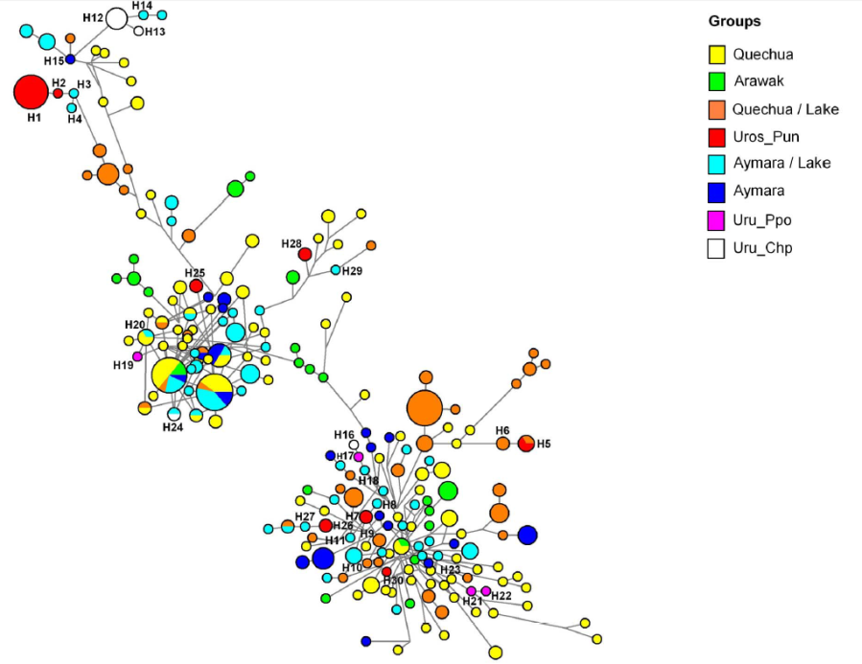
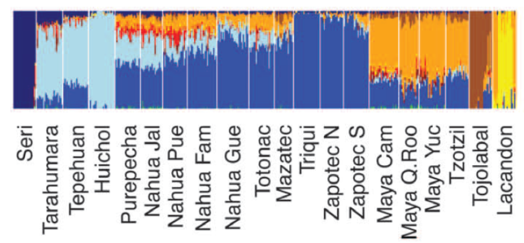
Genetic markers
Uniparental markers
Mitochondrial DNA: maternal lineages
Non recombinant Y-chromosome: paternal lineages
Biparental markers
Unique mutations (ex: SNP) on the autosomes
Genome-wide data
Millions of mutations across the genome
Median Joining network for STR haplotypes of one haplogroup among 22 Peruvian and Bolivian populations. (Sandoval et al., 2013)
Global ancestry proportions in Native Mexicans at K = 9.
(Moreno-Estrada et al. 2014)

Slide 5
Genetic markers
Uniparental markers
Mitochondrial DNA: maternal lineages
Non recombinant Y-chromosome: paternal lineages
Biparental markers
Unique mutations (ex: SNP) on the autosomes
Genome-wide data
Millions of mutations across the genome
Median Joining network for STR haplotypes of one haplogroup among 22 Peruvian and Bolivian populations. (Sandoval et al., 2013)
Global ancestry proportions in Native Mexicans at K = 9.
(Moreno-Estrada et al. 2014)

Slide 6
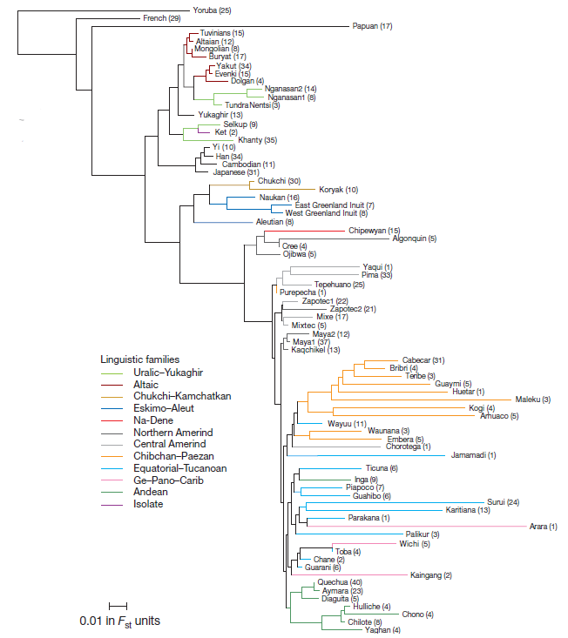
Genetic and Linguistic correlation
Language is a strong cultural constraint to gene flow.
BUT so are geography, history, religion, etc.
All studies on correlations between genetic data and linguistic diversity have relied on linguistic phylogenetic trees (ex : Greenberg, Ruhlen) from which classes or distances were infered.
Neighbour-joining tree based on Fst distances relating Native American to selected non-American populations. (Reich et al., 2012)

Slide 7
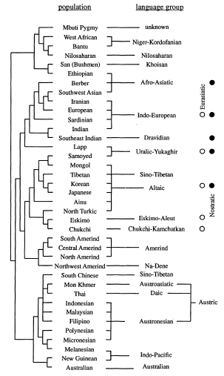
Earlier approaches
Cavalli-Sforza et al. (1992)

Slide 8
Earlier approaches
Cavalli-Sforza et al. (1992)

Slide 9
Belle and Barbujani (2007) define four linguistic distances:
  d_{LAN} = 1: different language, same family
  d_{LAN} = 2: different family, same branch
  d_{LAN} = 3: different branch, same phylum
  d_{LAN} = 4: different phyla (using two alternative
  classifications: Ruhlen and Ethnologue)

Slide 10
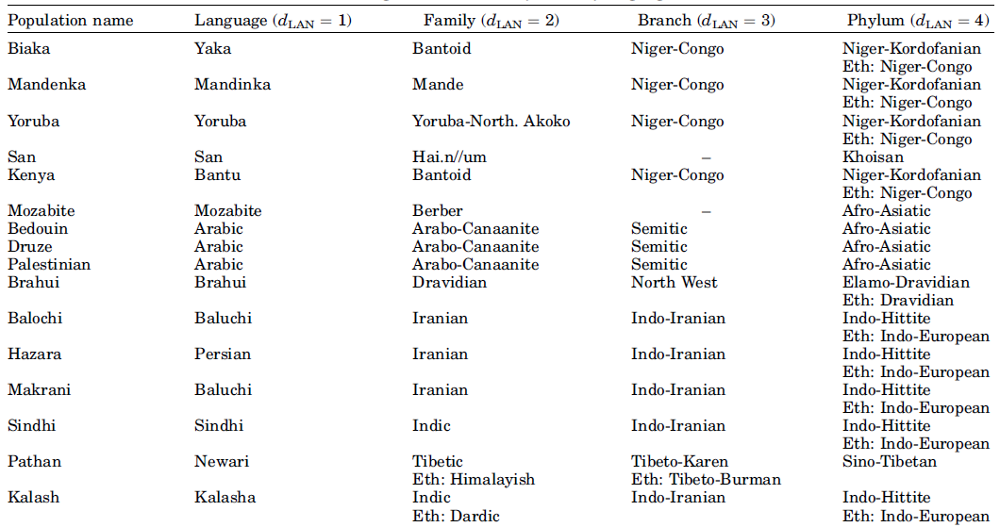
Examples

Slide 11
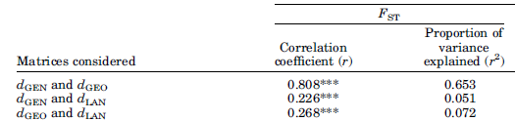
Results of Belle and Barbujani (2007)

Slide 12
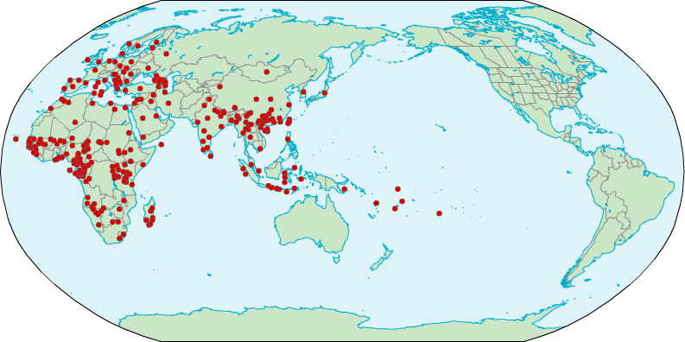
Our data
Map of current population-language matches

Slide 13
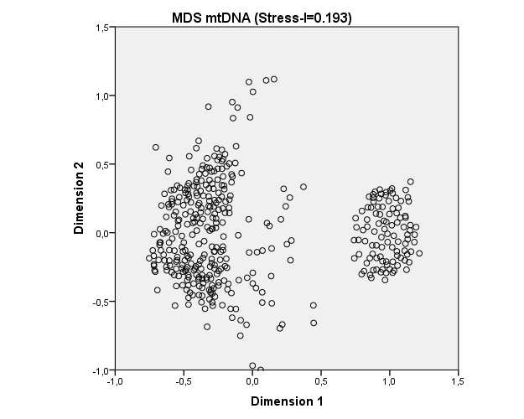
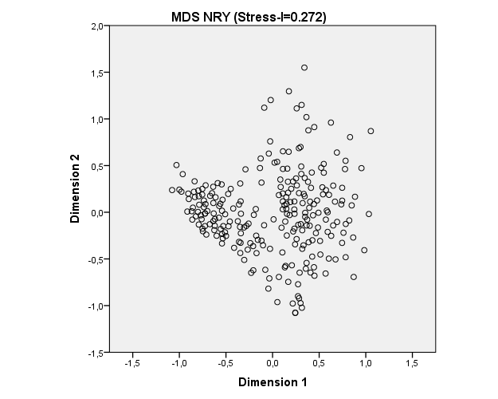
Our data
We have the beginnings of a large worldwide genetic and linguistic dataset, so far
• mtDNA: Npop =262
• Y-chromosome: Npop =152
• Linguistic distances ASJP: Npop =320
• Intersection all three: Npop =47
Africa
Asia
Europe
Africa
Asia
Europe

Slide 14
Our data
Linguistic distance measures based on average twice-normalized Levenshtein distances, more precisely so-called LDND (Wichmann et al 2010) from 40-item word lists from the database of the Automated Similarity Judgment Program.
Geographical distances measured as the crow flies

Slide 15
Results for Mantel tests
Linguistic distances explain 2.3% of the female genetic diversity and 4.8% of the male genetic diversity.
Geographical distances explain both male and female genetic diversity equally or better than do linguistic distances.
Mantel tests (1000 iterations) | Npop | R² | p
Language-mtDNA | 262 | 0,023 | < 10⁻³
Language-NRY | 152 | 0,048 | < 10⁻³
Geography-mtDNA | 262 | 0,023 | < 10⁻³
Geography-NRY | 152 | 0,068 | < 10⁻³
Geography-Language | 320 | 0,048 | < 10⁻³
These analyses bring only weak support for previously reported findings on correlations between linguistic and genetic data.
Moreover, simple correlation tests are not really warranted…

Slide 16
Approaching the outliers
What could combinations of extreme values of mtDNA, y-chromosome and linguistic distances suggest in terms of linguistic history?

Slide 17
Theoretical possibilities

Slide 18
Marriages within the
language group

Slide 19
Marriages within the
language group
females from different groups enter
same male population and shift

Slide 20
Two populations, same language:
a whole-sale language shift
Marriages within the
language group
females from different groups enter
same male population and shift

Slide 21
Males enter part of population and shift
or one group of females enter different
male populations who take their language.
Two populations, same language:
a whole-sale language shift
Marriages within the
language group
females from different groups enter
same male population and shift

Slide 22
Marriages within the
language group / dis-
appearance of signals)
Males enter part of population and shift
or one group of females enter different
male populations who take their language.
Two populations, same language:
a whole-sale language shift
Marriages within the
language group
females from different groups enter
same male population and shift

Slide 23
Females from same
group marry into
different male groups
and shift language
Marriages within the
language group / dis-
appearance of signals)
Males enter part of population and shift
or one group of females enter different
male populations who take their language.
Two populations, same language:
a whole-sale language shift
Marriages within the
language group
females from different groups enter
same male population and shift

Slide 24
Females from same
group marry into
different male groups
and shift language
Marriages within the
language group / dis-
appearance of signals)
Two languages, same
population: a whole-
sale language shift
Males enter part of population and shift
or one group of females enter different
male populations who take their language.
Two populations, same language:
a whole-sale language shift
Marriages within the
language group
females from different groups enter
same male population and shift

Slide 25
Females from same
group marry into
different male groups
and shift language
Marriages within the
language group / dis-
appearance of signals)
Two languages, same
population: a whole-
sale language shift
Males enter part of population and shift
or one group of females enter different
male populations who take their language.
Two populations, same language:
a whole-sale language shift
Marriages within the
language group
Males from same group marry
into different female groups and
shift language
females from different groups enter
same male population and shift

Slide 26
Actual data

Slide 27
A parenthesis explaining why there
are three DNA distance clouds
Africa
Asia
Europe

Slide 28
Putting back the ‚situation labels‘ back on the graph...

Slide 29
Females from same
group marry into
different male groups
and shift language
Marriages within the
language group / dis-
appearance of signals
Two languages, same
population: a whole-
sale language shift
Males enter part of population and shift
or one group of females enter different
male populations who take their language.
Two populations, same language:
a whole-sale language shift
Marriages within the
language group
Males from same group marry
into different female groups and
shift language
females from different groups enter
same male population and shift

Slide 30
Females from same
group marry into
different male groups
and shift language
Unattested cases
Marriages within the
language group / dis-
appearance of signals
Two languages, same
population: a whole-
sale language shift
Males enter part of population and shift
or one group of females enter different
male populations who take their language.
Two populations, same language:
a whole-sale language shift
Marriages within the
language group
Males from same group marry
into different female groups and
shift language
females from different groups enter
same male population and shift

Slide 31
Females from same
group marry into
different male groups
and shift language
Unattested cases
removed
Marriages within the
language group / dis-
appearance of signals
Two languages, same
population: a whole-
sale language shift
Marriages within the
language group
females from different groups enter
same male population and shift

Slide 32
Females from same
group marry into
different male groups
and shift language
Uninteresting
cases
Marriages within the
language group / dis-
appearance of signals
Two languages, same
population: a whole-
sale language shift
Marriages within the
language group
females from different groups enter
same male population and shift

Slide 33
Females from same
group marry into
different male groups
and shift language
Uninteresting
cases removed
Two languages, same
population: a whole-
sale language shift
females from different groups enter
same male population and shift

Slide 34
Undirected
female
floaters
All shift
Directed female floaters

Slide 35
Case studies

Slide 36
Some examples of female floaters
group1 | family | group2 | family | ling_dist | geo_dist | mt | ysnp
WUZLAM | Afro-Asiatic,Chadic | FANG | Niger-Congo,Bantoid | 100.51 | 644 | 0.1192 | 0.8651
PODOKO | Afro-Asiatic,Chadic | FANG | Niger-Congo,Bantoid | 104.23 | 645 | 0.1693 | 0.9158
TUPURI | Niger-Congo,Adamawa | NDANDA_SUD | Niger-Congo,Bantoid | 99.78 | 739 | 0.0334 | 0.9055
WUZLAM | Afro-Asiatic,Chadic | NDANDA_SUD | Niger-Congo,Bantoid | 100.63 | 766 | 0.0124 | 0.9052
PODOKO | Afro-Asiatic,Chadic | NDANDA_SUD | Niger-Congo,Bantoid | 99.14 | 768 | 0.0314 | 0.9400
WANDALA | Afro-Asiatic,Chadic | NDANDA_SUD | Niger-Congo,Bantoid | 101.98 | 797 | 0.0137 | 0.8032
Probably group1 are woman marrying into Bantoid groups as the latter expand

Slide 37
Whole-sale language shift: the case of Malagasy
group1 | family | group2 | family | ling_dist | geo_dist | mt | ysnp
SHONA_2 | Niger-Congo,Bantoid | MALAGASY _TANDROY_2 | Austron.,GreaterBarito | 103.29 | 1694 | 0.1608 | 0.1656
J62_RUNDI | Niger-Congo,Bantoid | MALAGASY _TANDROY_2 | Austron.,GreaterBarito | 100.56 | 2946 | 0.1464 | 0.1585
NGANGELA | Niger-Congo,Bantoid | MALAGASY _TANDROY_2 | Austron.,GreaterBarito | 98.92 | 3041 | 0.1874 | 0.1594
SANDAWE | Sandawe | MALAGASY _ANTAISAKA | Austron.,GreaterBarito | 94.66 | 2439 | 0.1217 | 0.1318
MALAGASY _TANDROY_2 | Austron.,GreaterBarito | MALAGASY _ANTAISAKA | Austron.,GreaterBarito | 44.26 | 1617 | 0.1137 | 0.0240
African groups shifting entirely to Malgasy

Slide 38
“Arabs” tend to have large mtDNA distances and small
linguistic distances, implying directed female floaters
or whole-sale language shift
 | Chad Arabs Chad | Chad Arabs Shuwa | Dubai Arab | Egypt Arab | Egypt Copte | Iraq | Israel Druze | Jordania | Morocco Arab Figuig
Chad Arabs Shuwa
Dubai Arab | 0.8200 | 0.8235
Egypt Arab |  |  | 0.8223
Egypt Copte |  |  | 0.8255
Iraq | 0.8723 | 0.8780 |  | 0.8462 | 0.8587
Israel Druze | 0.7552 | 0.7595 |  | 0.7689 | 0.7664
Jordania | 0.7182 | 0.7307 |  | 0.7590 | 0.7531
Morocco Arab Figuig |  |  | 0.8271 |  |  | 0.8692 | 0.7653 | 0.7532
Yemen | 0.8182 | 0.8242 | 0.8271 | 0.8228 | 0.8275 |  |  |  | 0.8318
Linguistic distances between 31.44 and 67.31 — varieties of Arabic
(here using all data for which mtDNA and languages are available,
not just those for which y chromosome data is also available)

Slide 39
Looking at speakers of Arabic for which all three distances are available – y chromosome distances tend to be small suggesting female floaters at least in this case
group1 | group2 | ling_dist | geo_dist | mt | ysnp
YEMEN_SANAANI_ARABIC | IRAQ_MUSLIM_BAGHDAD_ARABIC | 42.18 | 1889 | 0.0620 | 0.1257
YEMEN_SANAANI_ARABIC | CAIRO_ARABIC | 45.18 | 2042 | 0.8228 | 0.1487
CAIRO_ARABIC | IRAQ_MUSLIM_BAGHDAD_ARABIC | 31.44 | 1275 | 0.8462 | 0.0794

Slide 40
Discussion
Bringing typological features into the mix
  Female floaters shifting language and whole-sale language shift are expected to result in substrate effects and eventually linguistic IBD effect in typology, which is exactly what we find
  So we should study the distribution of typological features in conjunction with genetics

Slide 41
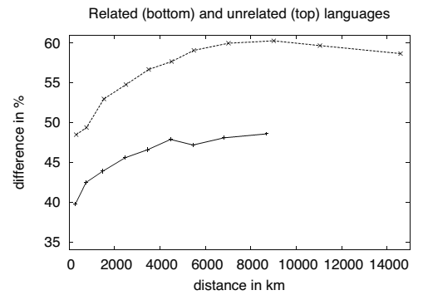
Typological (WALS) distances as a function of geography
(from Holman et al. 2007: 397)
Typological curve monotonic like
the mt curve (and continues to
rise beyond 5000 km)
mt curve monotonic and steep up to ~5000 km
ysnp curve non-monotonic and less steep
→ mt data give a better areal signal

Slide 42
Future work
Expand the genetic database and make it generally available along with good metadata.
Include typology.
Develop a better geographical distance measure.
Develop some numerical cut-off for treating a certain combination of linguistic, genetic, and geographical distances as indicative of one or the other type of contact.
Develop visualizations along the lines of the map highlighting language-mtDNA mismatches.
Model processes of gene flow, language contact, and migration through simulations.
Quantify the amount of language shift in prehistory.

Slide 43
References
Belle, Elise M. S. and Guido Barbujani. 2007. Worldwide analysis of multiple microsatellites: Language diversity has a detectable influence on DNA diversity. American Journal of Physical Anthropology 133:1137-1146.
Cavalli-Sforza, L. L., Erich Minch, and J. L. Mountain. 1992. Coevolution of genes and languages revisited. Proceedings of the National Academy of Sciences of the U.S.A. 89(12): 5620-5624.
Holman, Eric W., Christian Schulze, Dietrich Stauffer, and Søren Wichmann. 2007. On the relation between structural diversity and geographical distance among languages: observations and computer simulations. Linguistic Typology 11.2: 395-423.
Roewer et al. 2014 Continent-wide decoupling of Y-chromosomal genetic variation from language and geography in Native South Americans. PLOS Genetics 9(4):e1003460.
Wichmann, Søren, Eric W. Holman, Dik Bakker, and Cecil H. Brown. 2010. Evaluating linguistic distance measures. Physica A. 389: 3632-3639.

